Slide 1
Create a Spectral Library and Search Data with DIA-NN
Created by: Kyle Swovick
Created on: 10/26/22

Slide 2
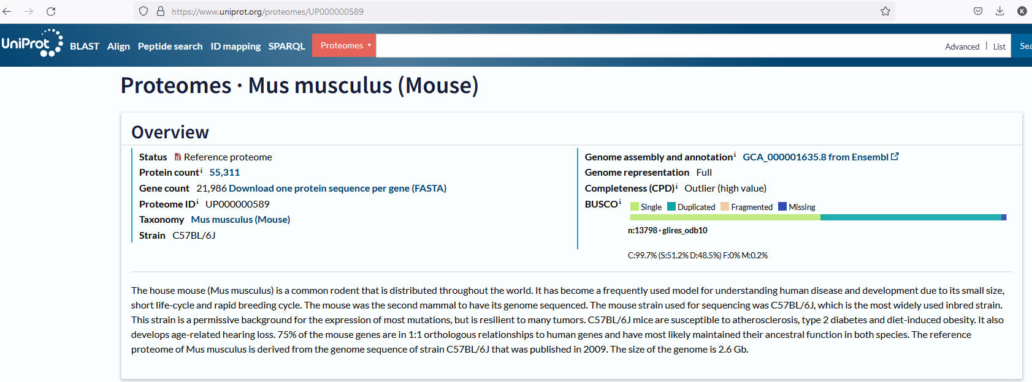
Create Spectral Library (using mouse as example)
Go to the uniport proteome page for your specific species
Click ‘Download one protein sequence per gene (FASTA)’

Slide 3
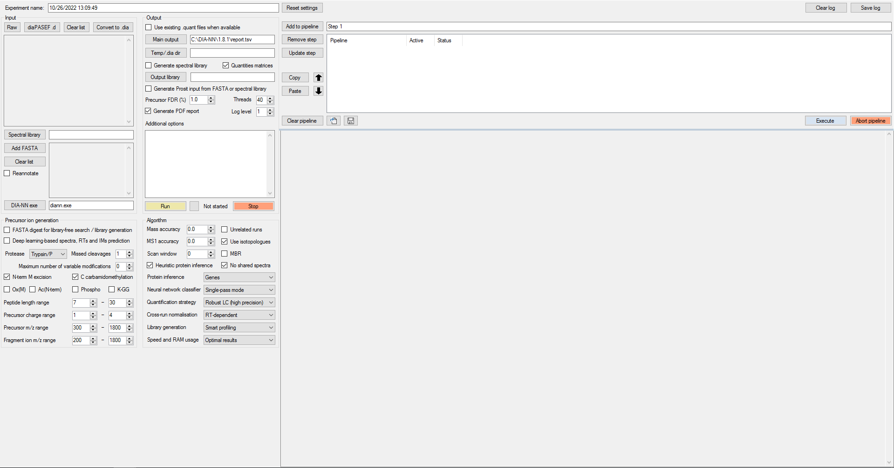
Create Spectral Library (using mouse as example)
Click
“Add FASTA”

Slide 4
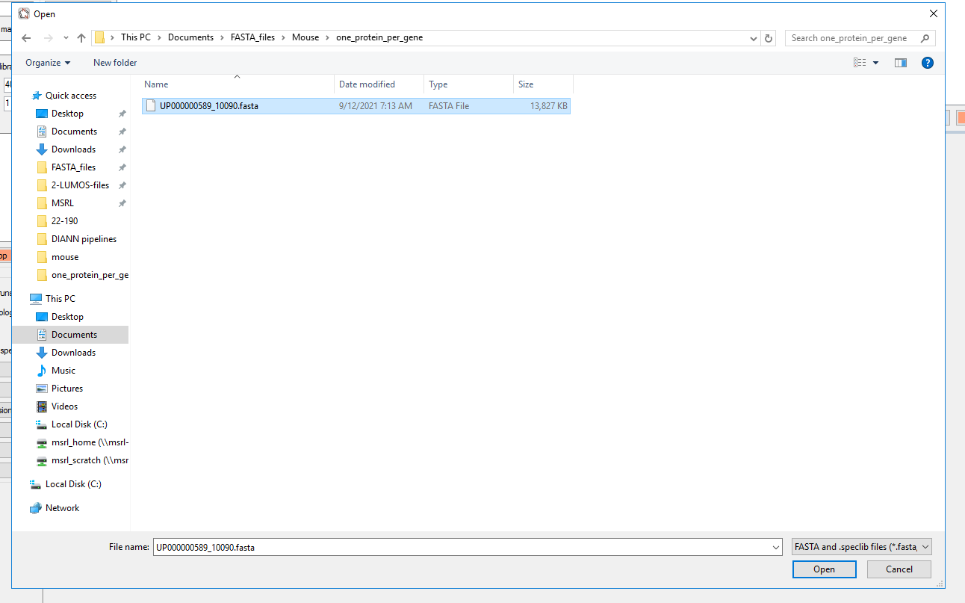
Create Spectral Library (using mouse as example)
Within the file browser, select the appropriate, decompressed
FASTA file

Slide 5
Create Spectral Library (using mouse as example)
Click
“Add FASTA”

Slide 6
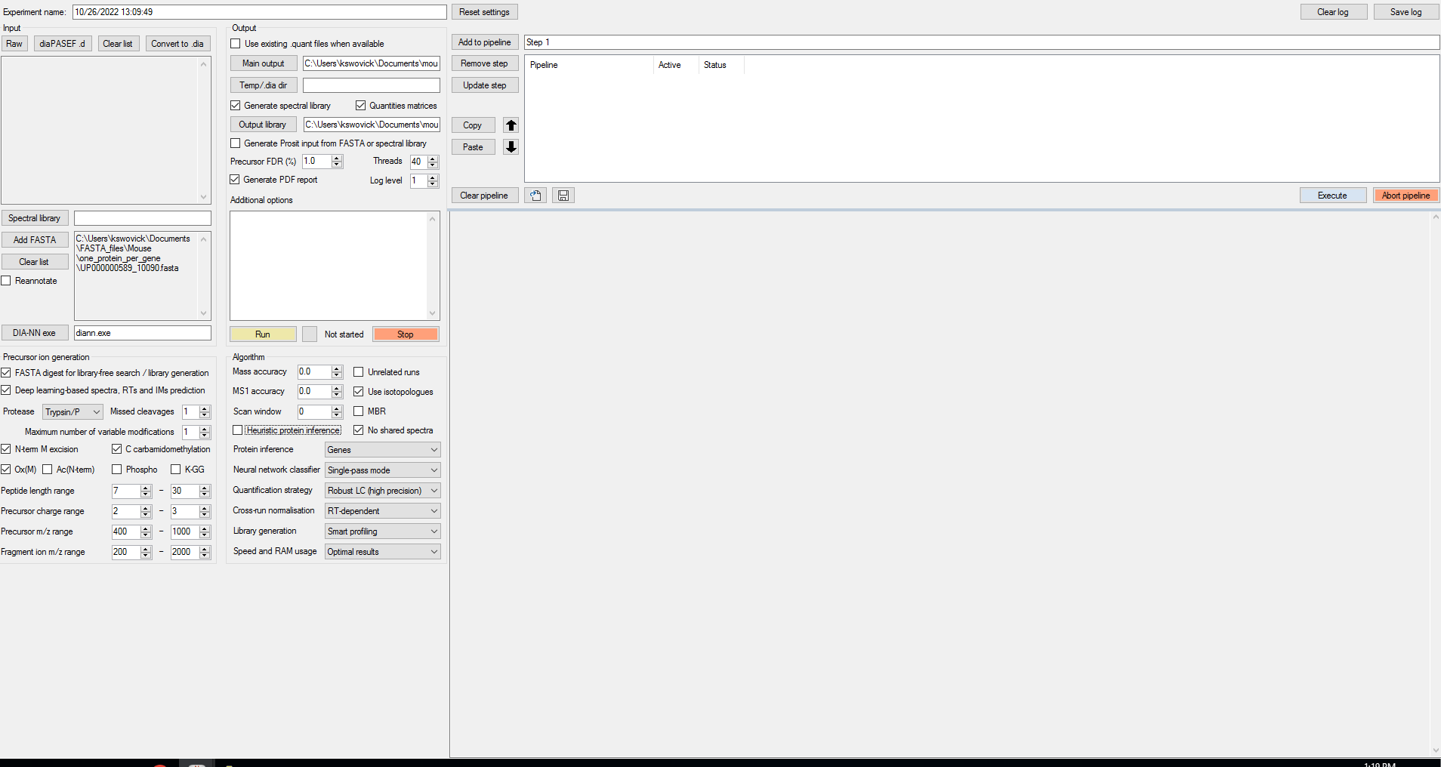
Create Spectral Library (using mouse as example)
1&2- Enables the machine learning algorithm to make a spectral library from the supplied FASTA file
3- Enable PTMs to include. We only use OxMet as variable so as not to make the search space overly complex.
4- Precursor charge range. 2-3 works best for our setup
5- Precursor m/z range. Our current methods all use 400-1000mz
6- Fragment ion m/z range. Our current methods all use 200-2000mz.
7-Main output. Opens a file browser to select where to write report output.
8-Output library. Opens a file browser to select where to write the spectral library.
9- Match-between-runs (MBR). Do not toggle when making an in silico spectral library.
10- Heuristic protein inference- Toggle off when making an in silico spectral library.
11- Run. Starts the search.
7
8
11
1
2
9
3
10
4
5
6

Slide 7
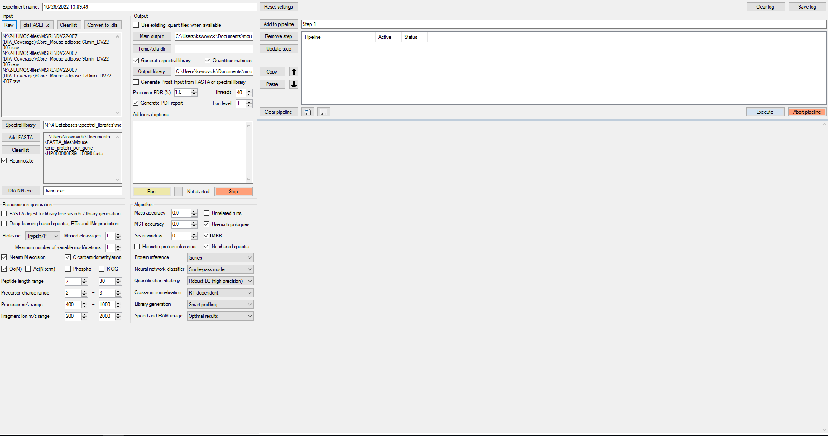
Search .raw Data (using mouse as example)
1- Opens a file browser to choose which .raw files you want analyzed.
2- Opens a file browser to choose which spectral library you want to use. (Can be in the following formats: .tsv, .txt, .csv, .speclib)
3- Opens a file browser to choose which FASTA file to use.
4- Reannotate. Using the supplied FASTA, it will annotate your results with gene and protein names.
5- Enable PTMs to include. We only use OxMet as variable so as not to make the search space overly complex.
6- Precursor charge range. 2-3 works best for our setup
7- Precursor m/z range. Our current methods all use 400-1000mz
8- Fragment ion m/z range. Our current methods all use 200-2000mz.
9- Main output. Opens a file browser to select where to write report output.
10- Output library. Opens a file browser to select where to write the spectral library.
11- Match-between-runs (MBR). When toggled, a spectral library is made with the provided DIA data. The data is then re-searched with this newly created library. When enabled, filter using Lib.Q. and Lib.PG.Q.Values.
12- Heuristic protein inference- Using an ML algorithm, DIA-NN tries to group precursors together into one gene instead of protein groups. Toggle off when performing differential expression analysis.
13- Run. Starts the search.
1
9
10
2
3
4
13
11
5
12
6
7
8

